Slide 1
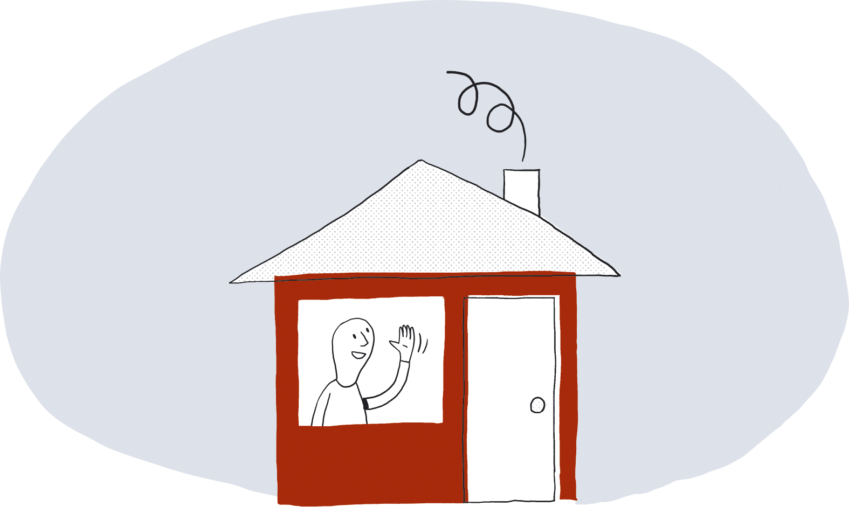
ENGELSK
Fire safety in the home
brannvernforeningen.no

Slide 2
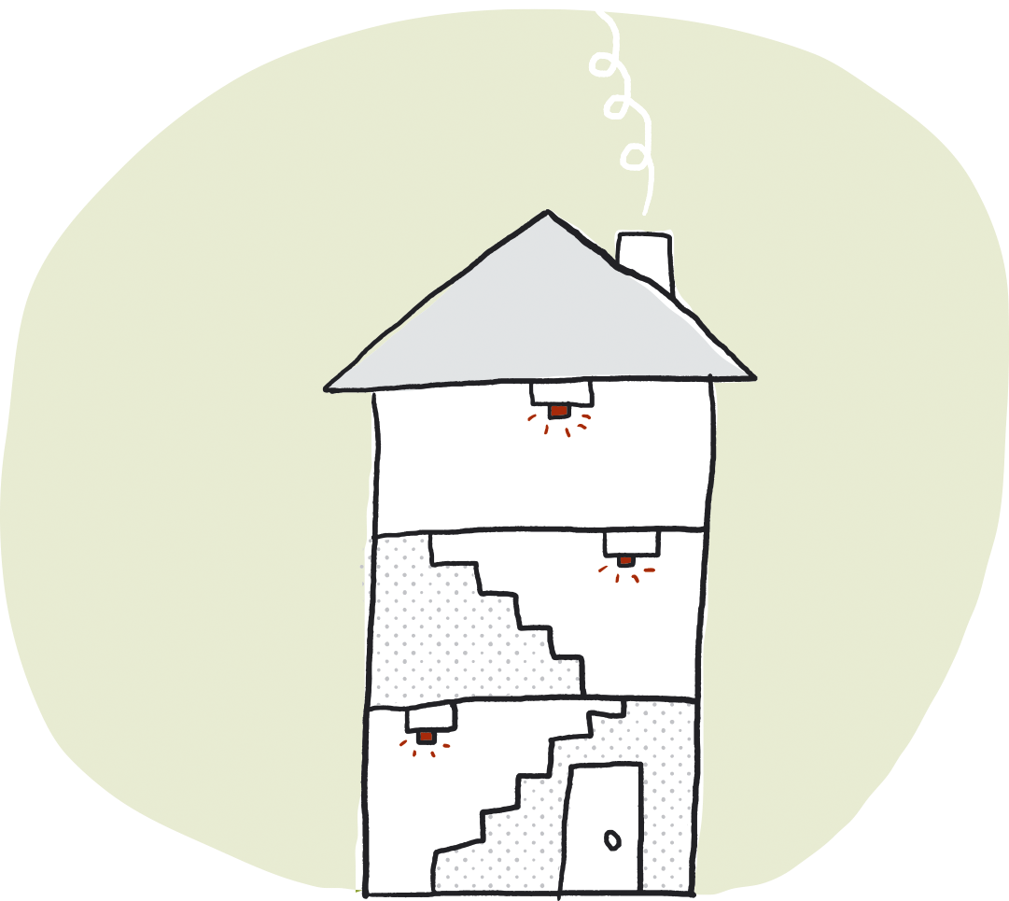
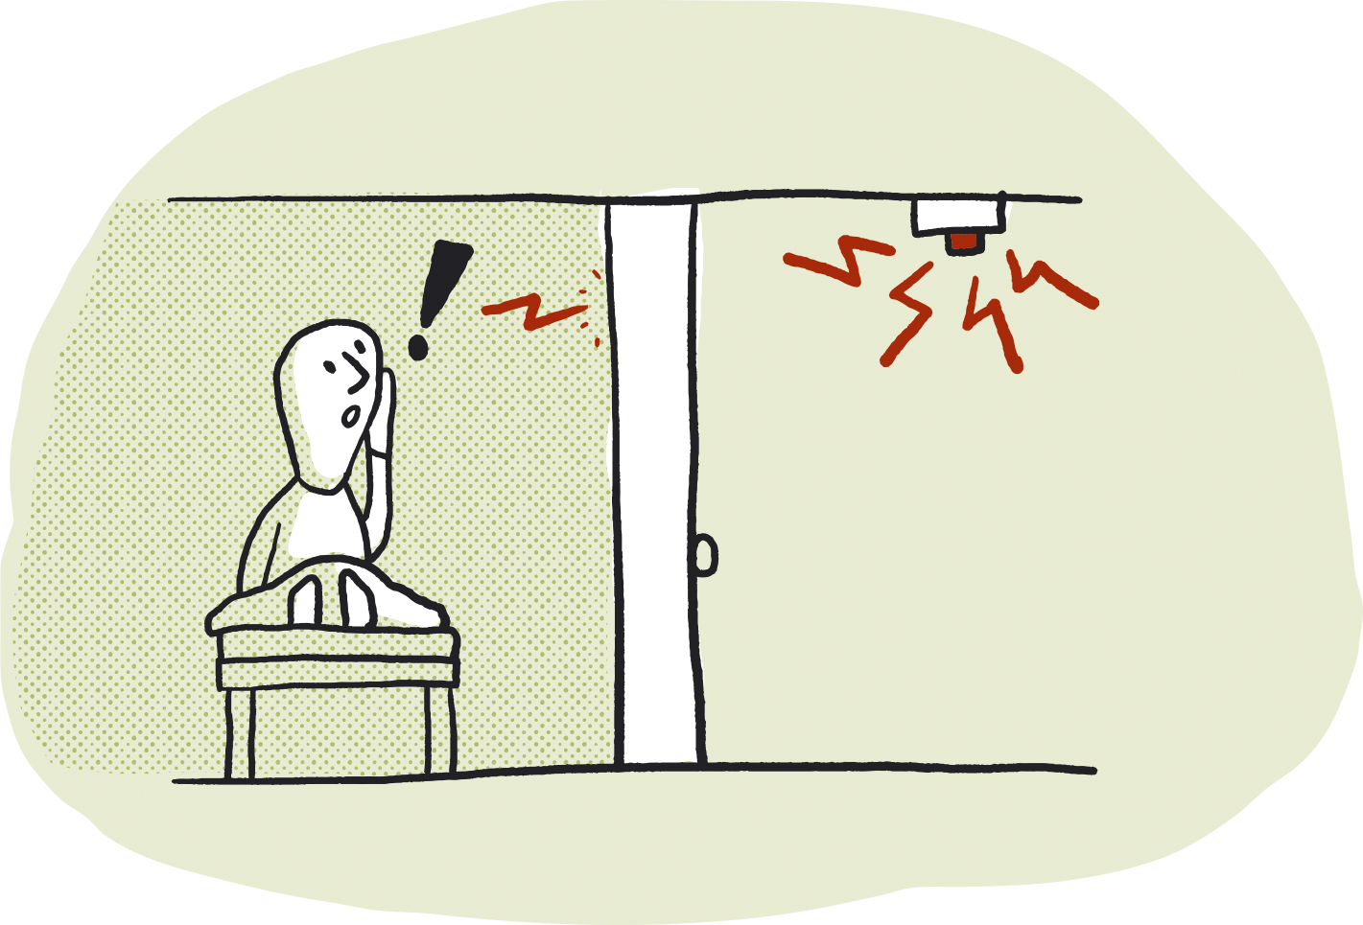
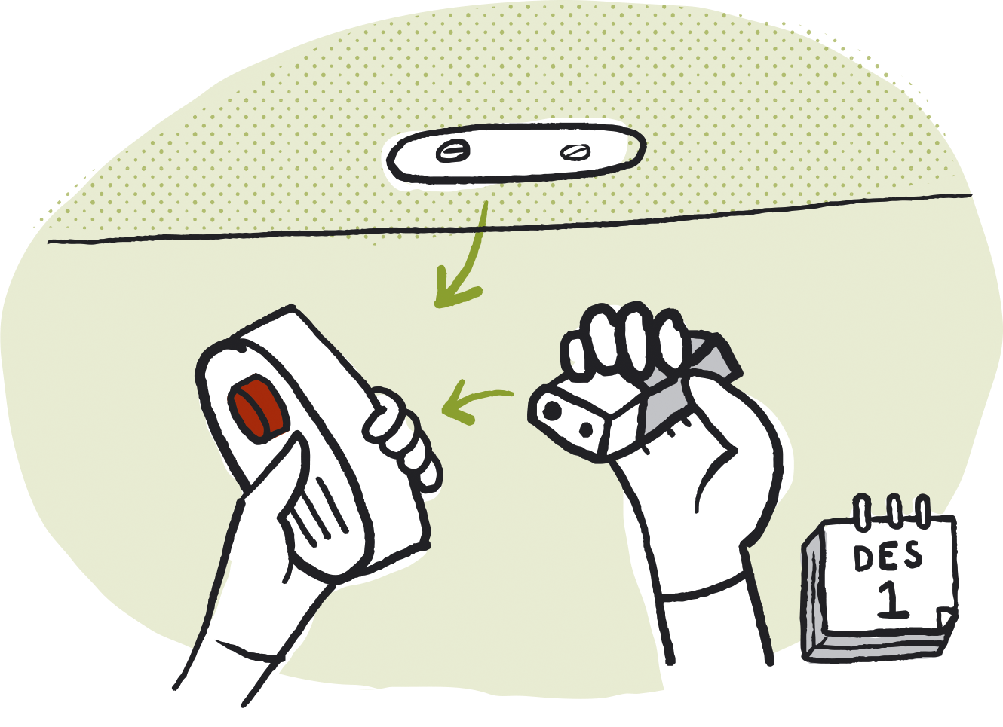
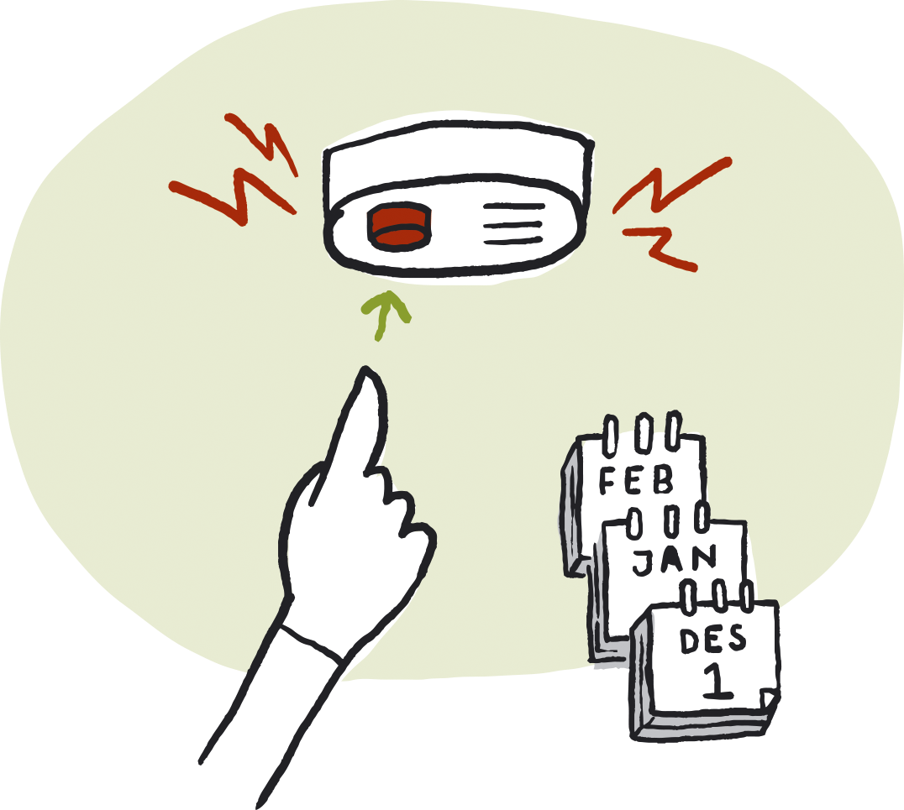
Mandatory smoke detectors
Every home must have at least one smoke detector on each floor. The smoke detectors provide an early warning in the event of a fire. You must be able to hear the alarm from inside bedrooms with the doors closed. The batteries must normally be replaced once a year. Test your smoke alarms regularly by pressing the test button.

Slide 3
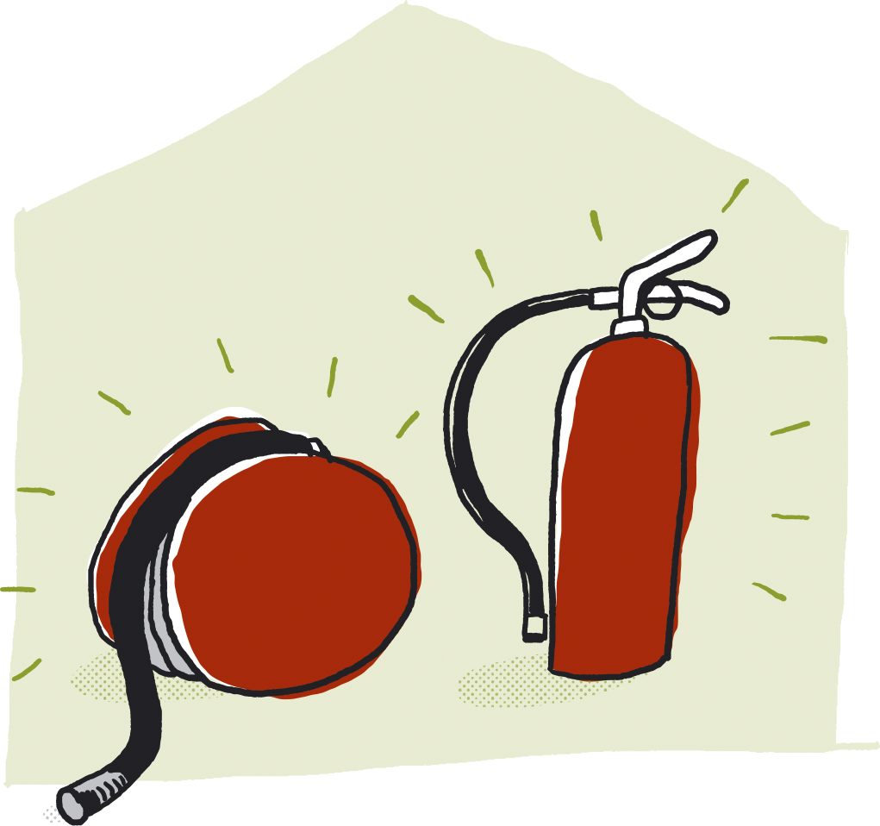
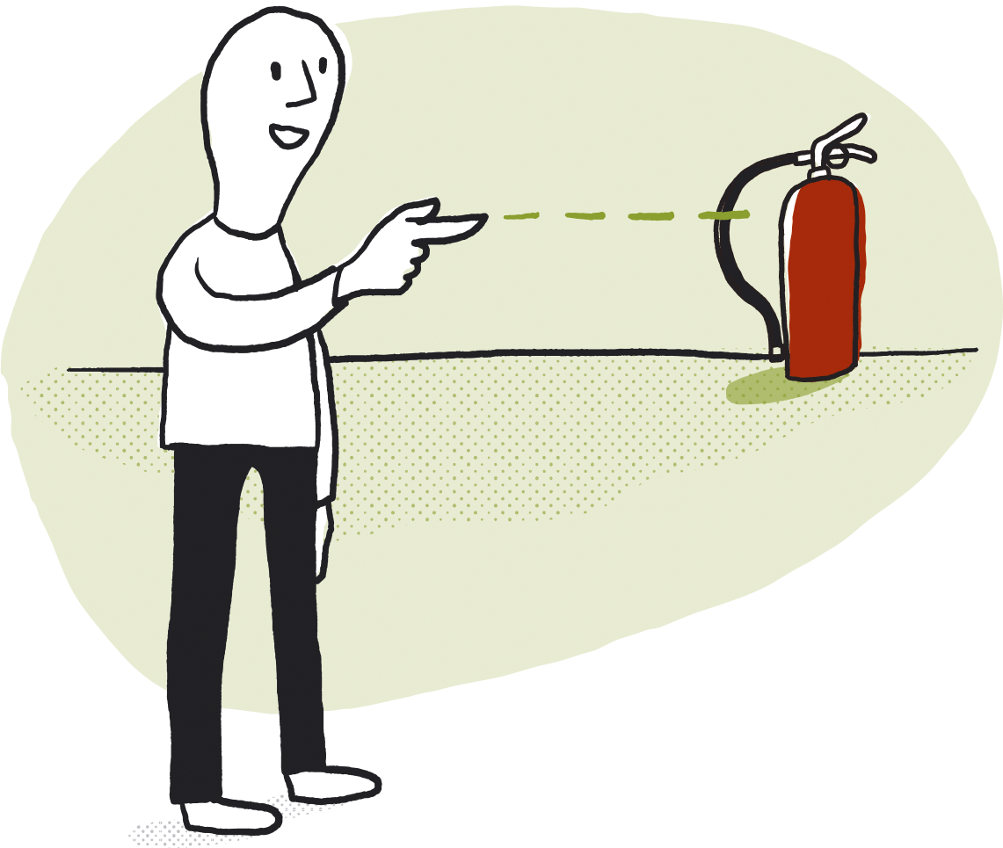
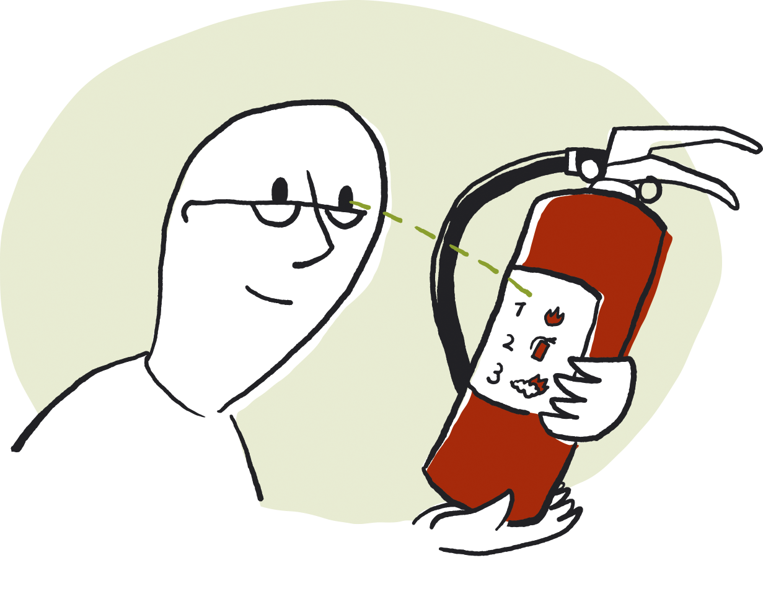
Mandatory fire extinguishing equipment
Every home must have a fire hose or a fire extinguisher. You are recommended to have both. The fire extinguishing equipment must be easily accessible. Everyone living at the property must know where the equipment is located. Read the instructions for use carefully.

Slide 4
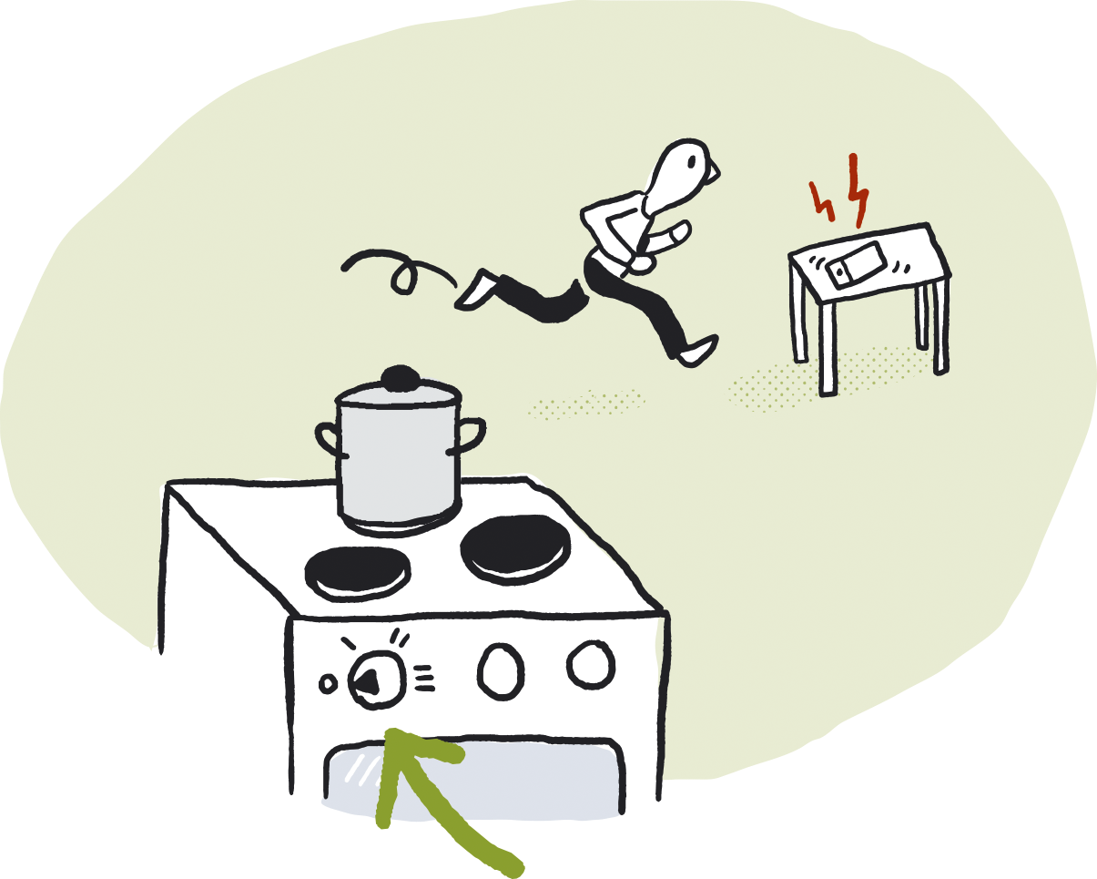
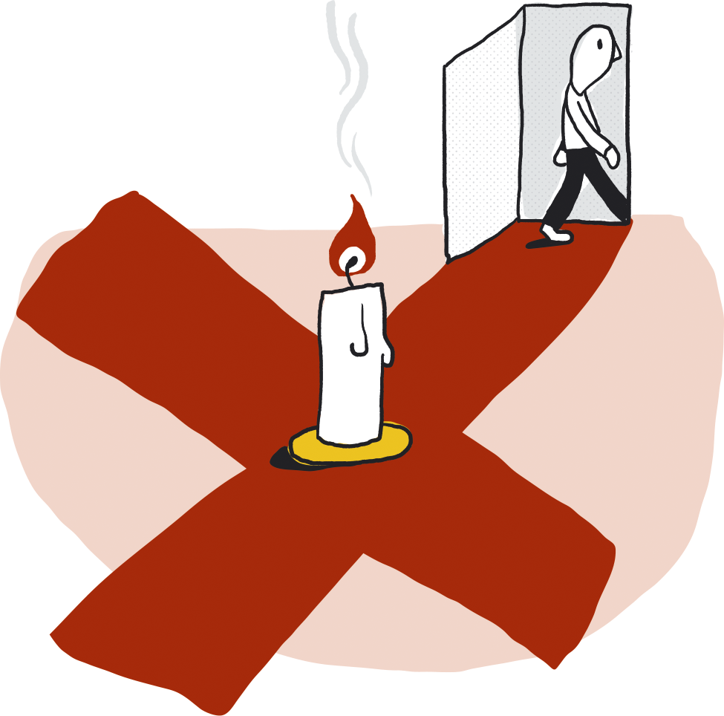
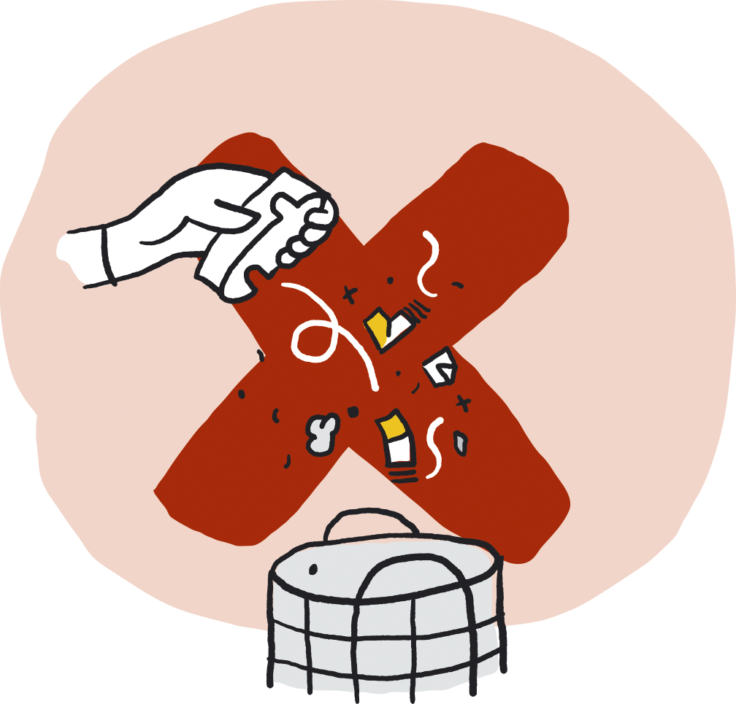
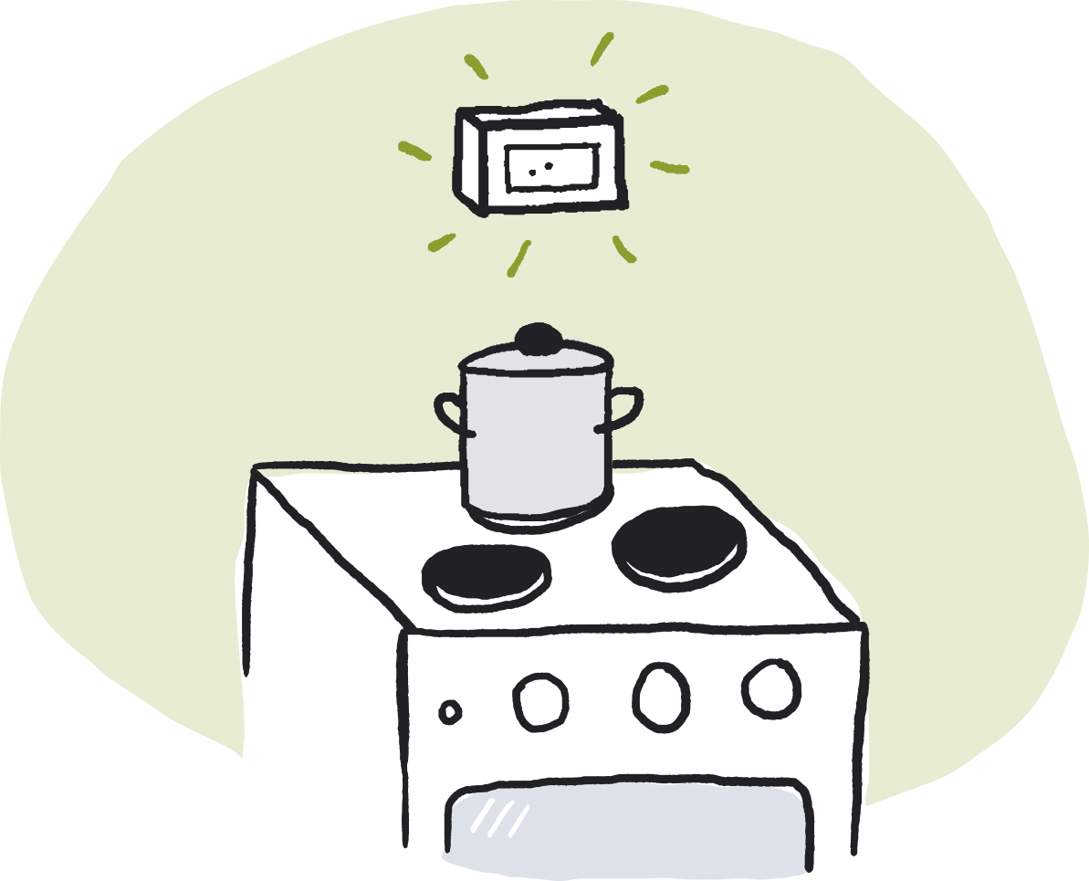
Fire prevention 1
Keep an eye on the cooker when it is in use. If you are interrupted when cooking, turn off all the rings on the hob. Install a cooker alarm/automatic shut-off device. Be careful when using an open flame. Never leave a room containing a burning candle. Lit candles must not be placed near flammable materials. Empty any ash in a safe place. Do not throw hot ash in a rubbish bin.

Slide 5
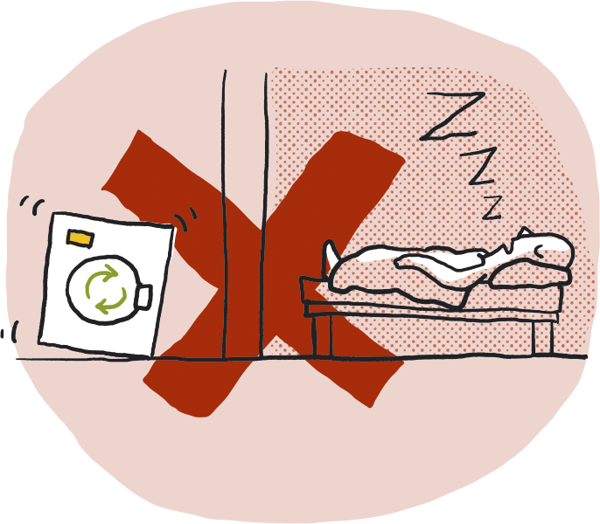
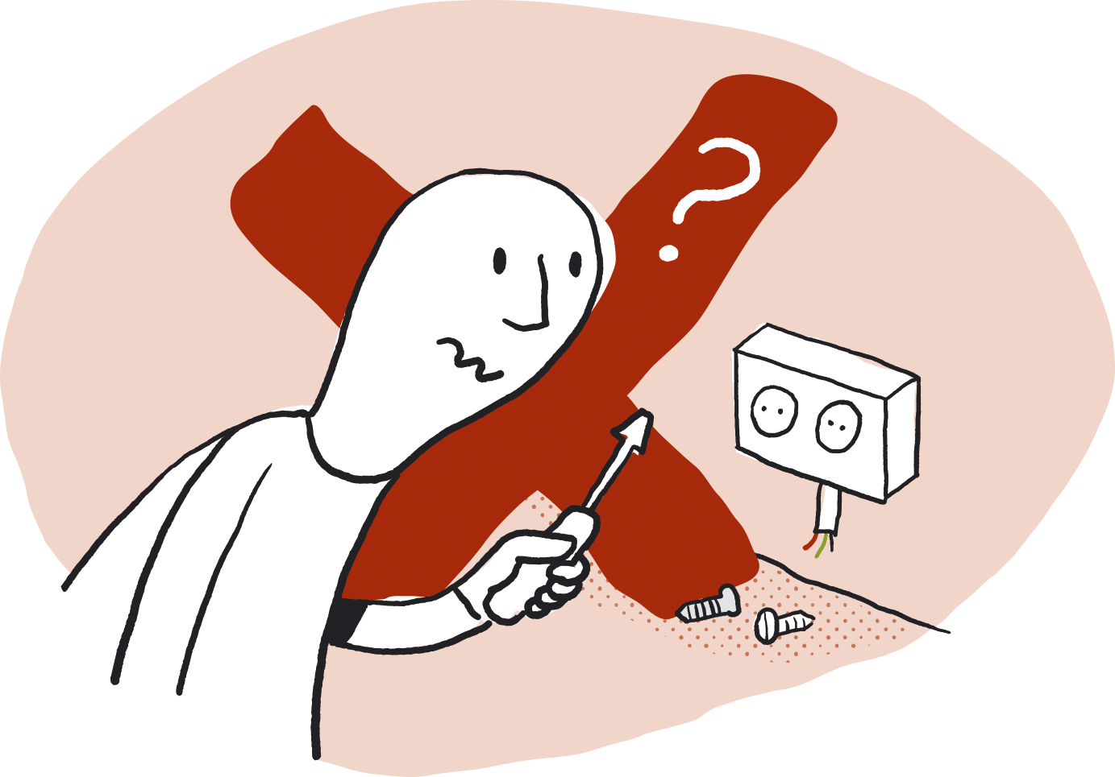
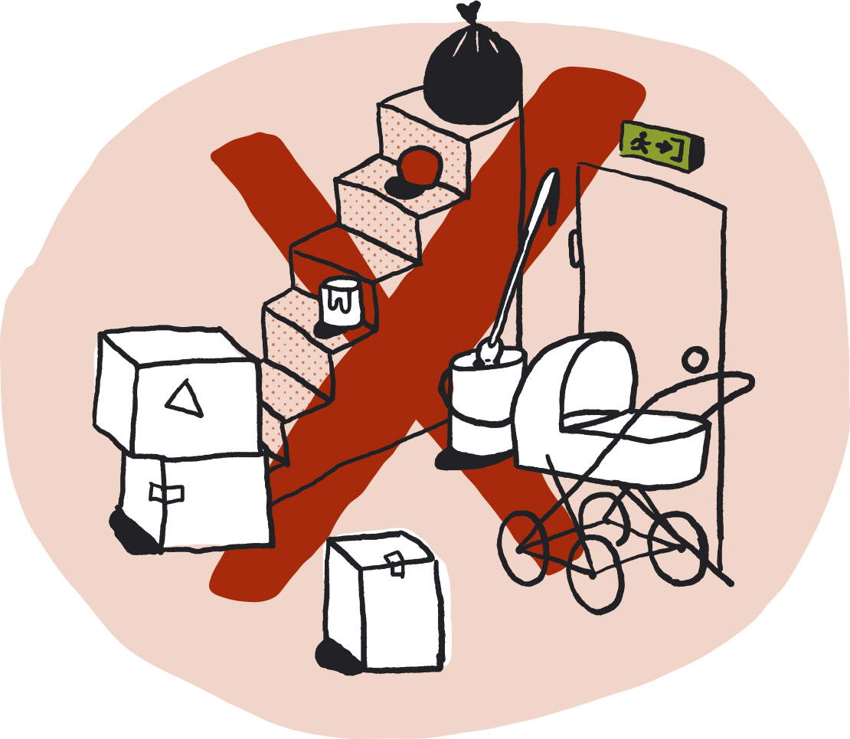
Fire prevention 2
Always turn off washing machines and tumble dryers when you leave home or go to bed. Only qualified electricians are allowed to install and repair electrical equipment and installations. Building materials, cardboard boxes and other refuse left lying about are often used when fires are started deliberately. Make sure stairwells and garages are kept clear of flammable items. Place rubbish containers well away from buildings.

Slide 6
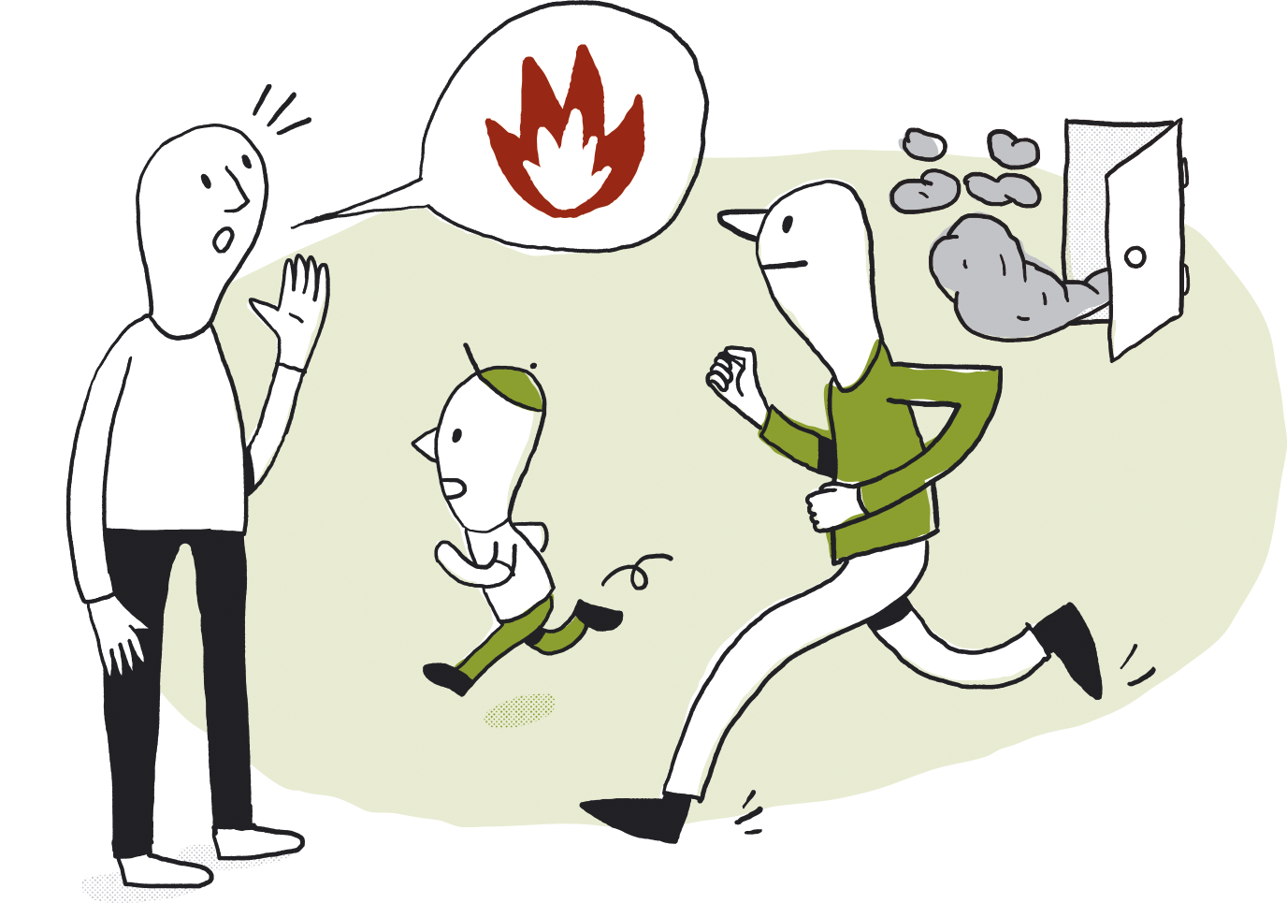
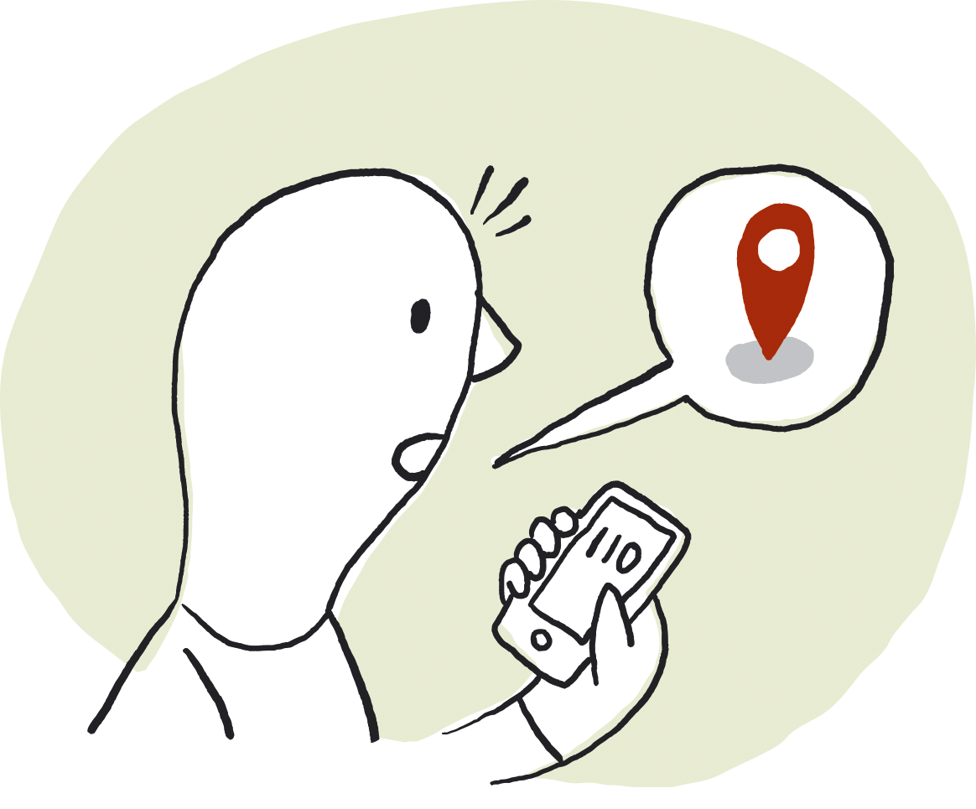
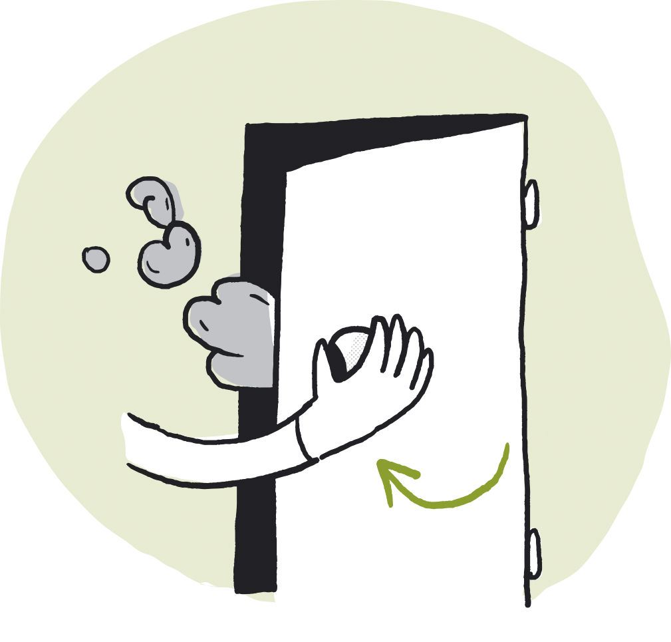
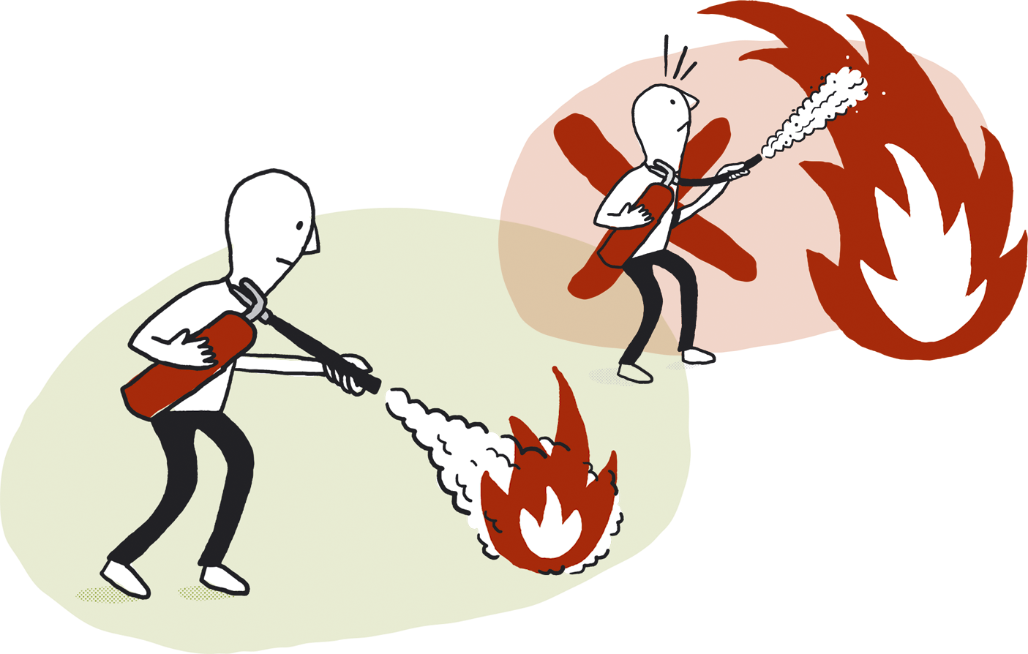
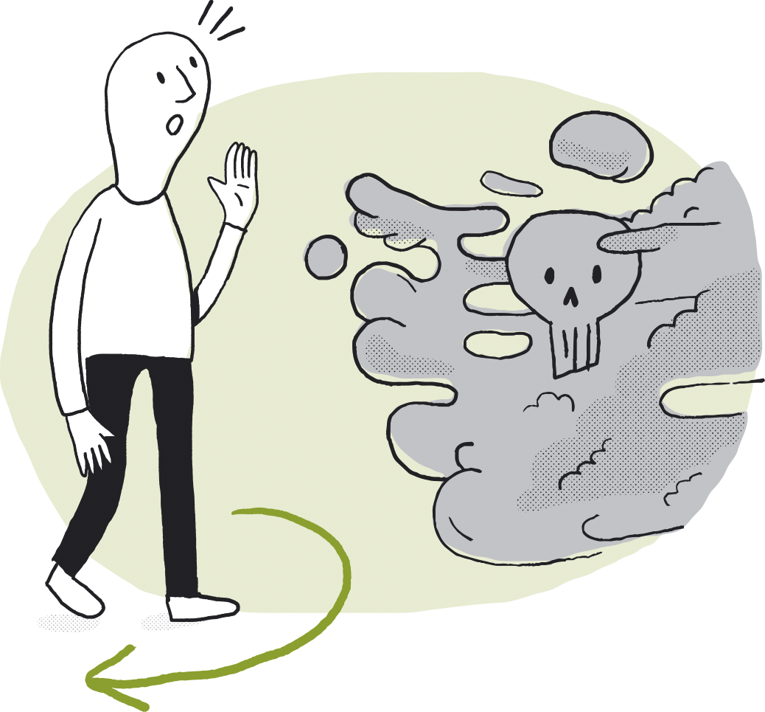
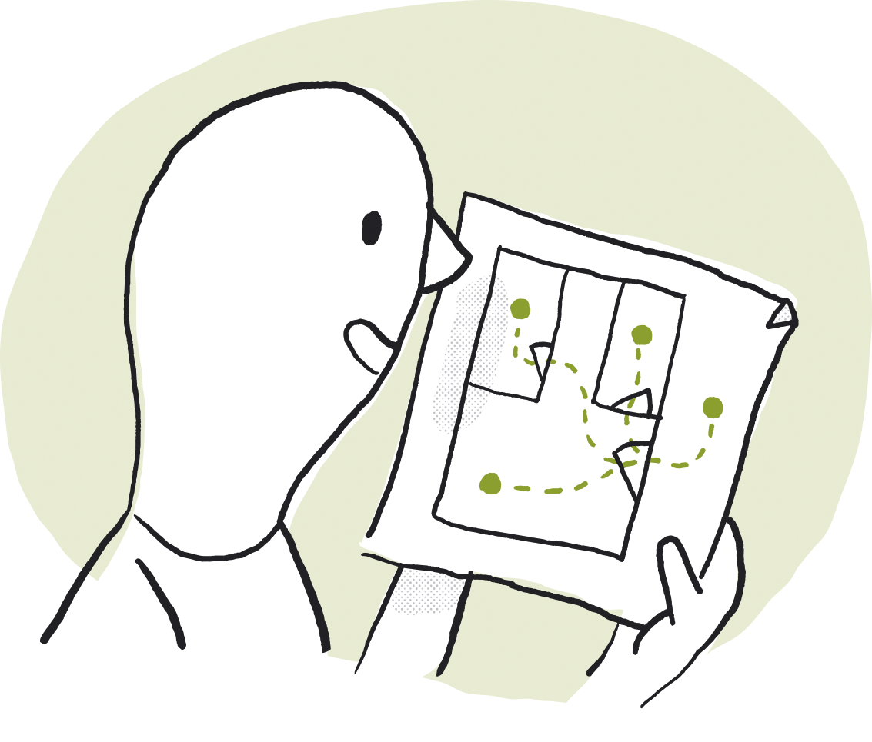
What to do in the event of a fire
1) EVACUATE
Make sure everyone gets out safely. Escaping through smoke is dangerous. Close doors. Make your way to a previously agreed assembly point.
2) NOTIFY
Notify the fire service by calling the emergency number 110. State the precise address of the burning building.
3) EXTINGUISH
If the fire has not become too big, try to put it out with a fire hose or fire extinguisher. Do not put yourself at risk. Smoke is highly toxic.
Your assessment of the situation will determine the order in which you decide to carry out these steps. It is useful to hold regular fire drills, so everyone can practise what to do.

Slide 7
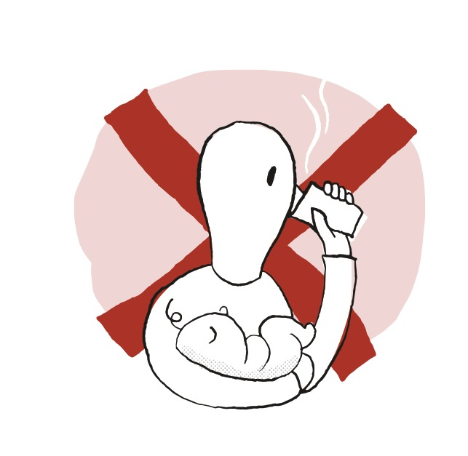
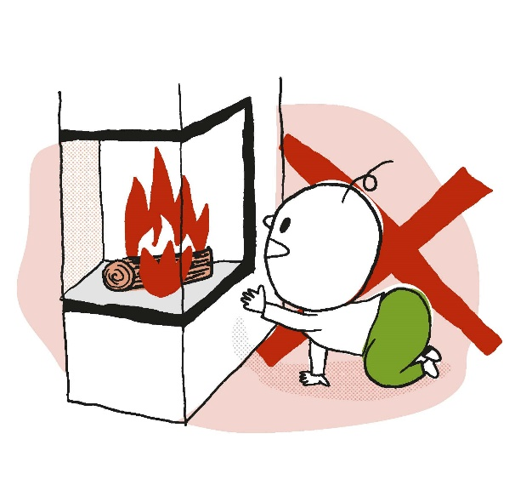
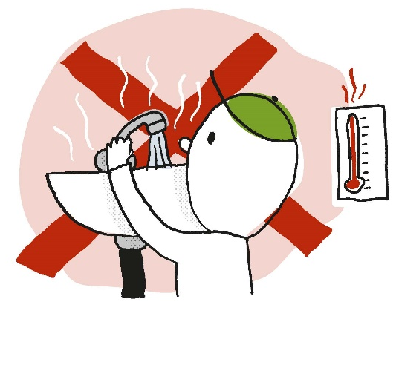
PREVENTING BURN INJURIES IN CHILDREN
Do not consume hot drinks when you are breastfeeding or holding a child.
Ensure that children do not have free access to hot surfaces such as fireplaces, heaters/radiators, ovens and similar.
Carefully monitor the water temperature in bathtubs and ensure that children cannot turn on any hot water. Regulate the temperature at the hot water heater.

Slide 8
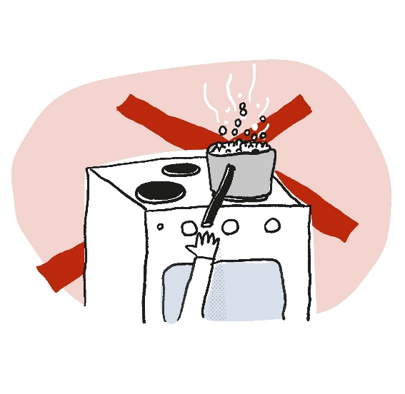
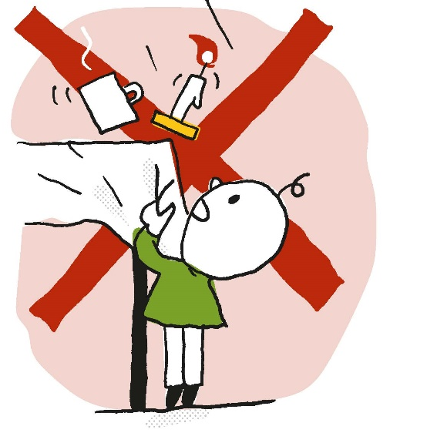
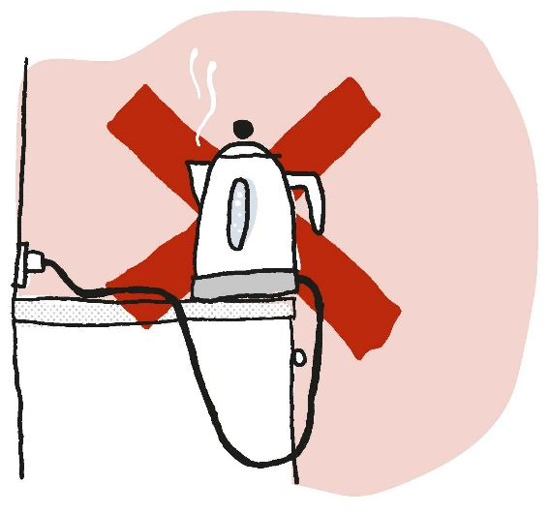
PREVENTING BURN INJURIES IN CHILDREN
Keep children well away from boiling pans etc.
Kettle – think about the placement of both the kettle itself and the cable.
Take care with tables that have tablecloths with hot coffee cups, candles etc. Children can drag these onto themselves.

Slide 9
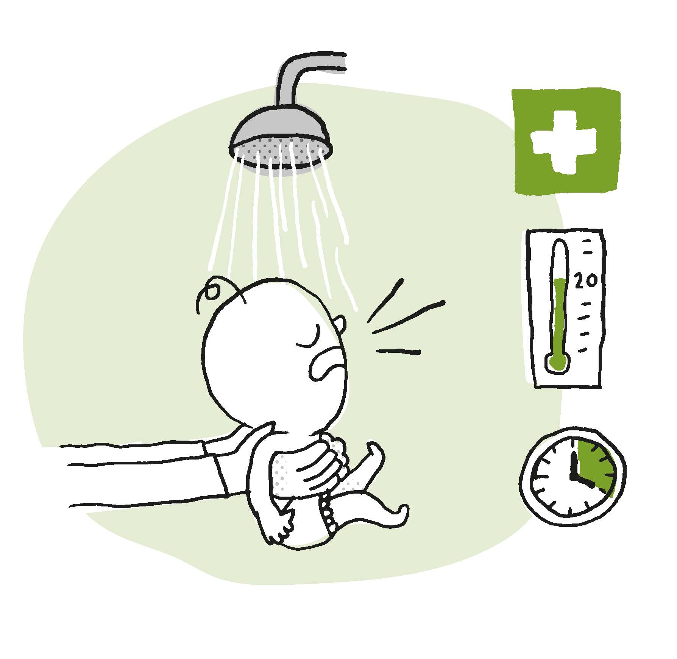
IF A CHILD SUFFERS BURNS
Cool down the burn site with water at 20 degrees C for 20 minutes if there is a suspicion of a serious burn injury.
HUSK 20 - 20
REMEMBER: 20 - 20

Slide 10
This brochure is available in over 30 different languages from the Norwegian Fire Protection Association’s website: www.brannvernforeningen.no/brannsikker

